Slide 1
TCA Project Part 1
Ryan Yuan

Slide 2
Project Overview
Design a TCA contour for an RP-1/LOX engine and calculate critical values
Equilibrium Model
Program a calculator to find the mole fractions, chamber temperature, and other critical values at chemical equilibrium
MR = 2.0
TCA Contour
Choose a MR and NFZ model
Calculate performance variables
Design a TCA contour

Slide 3
Equilibrium Calculator

Slide 4
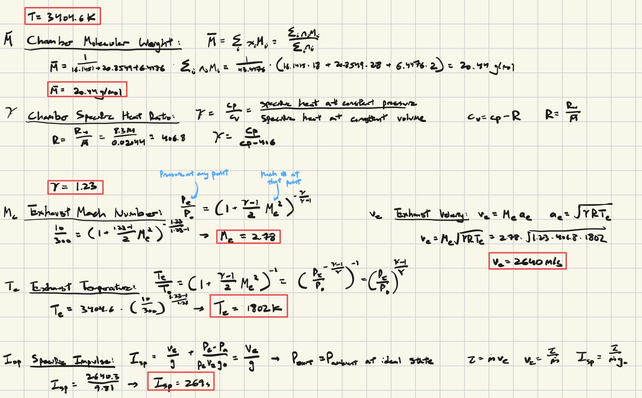
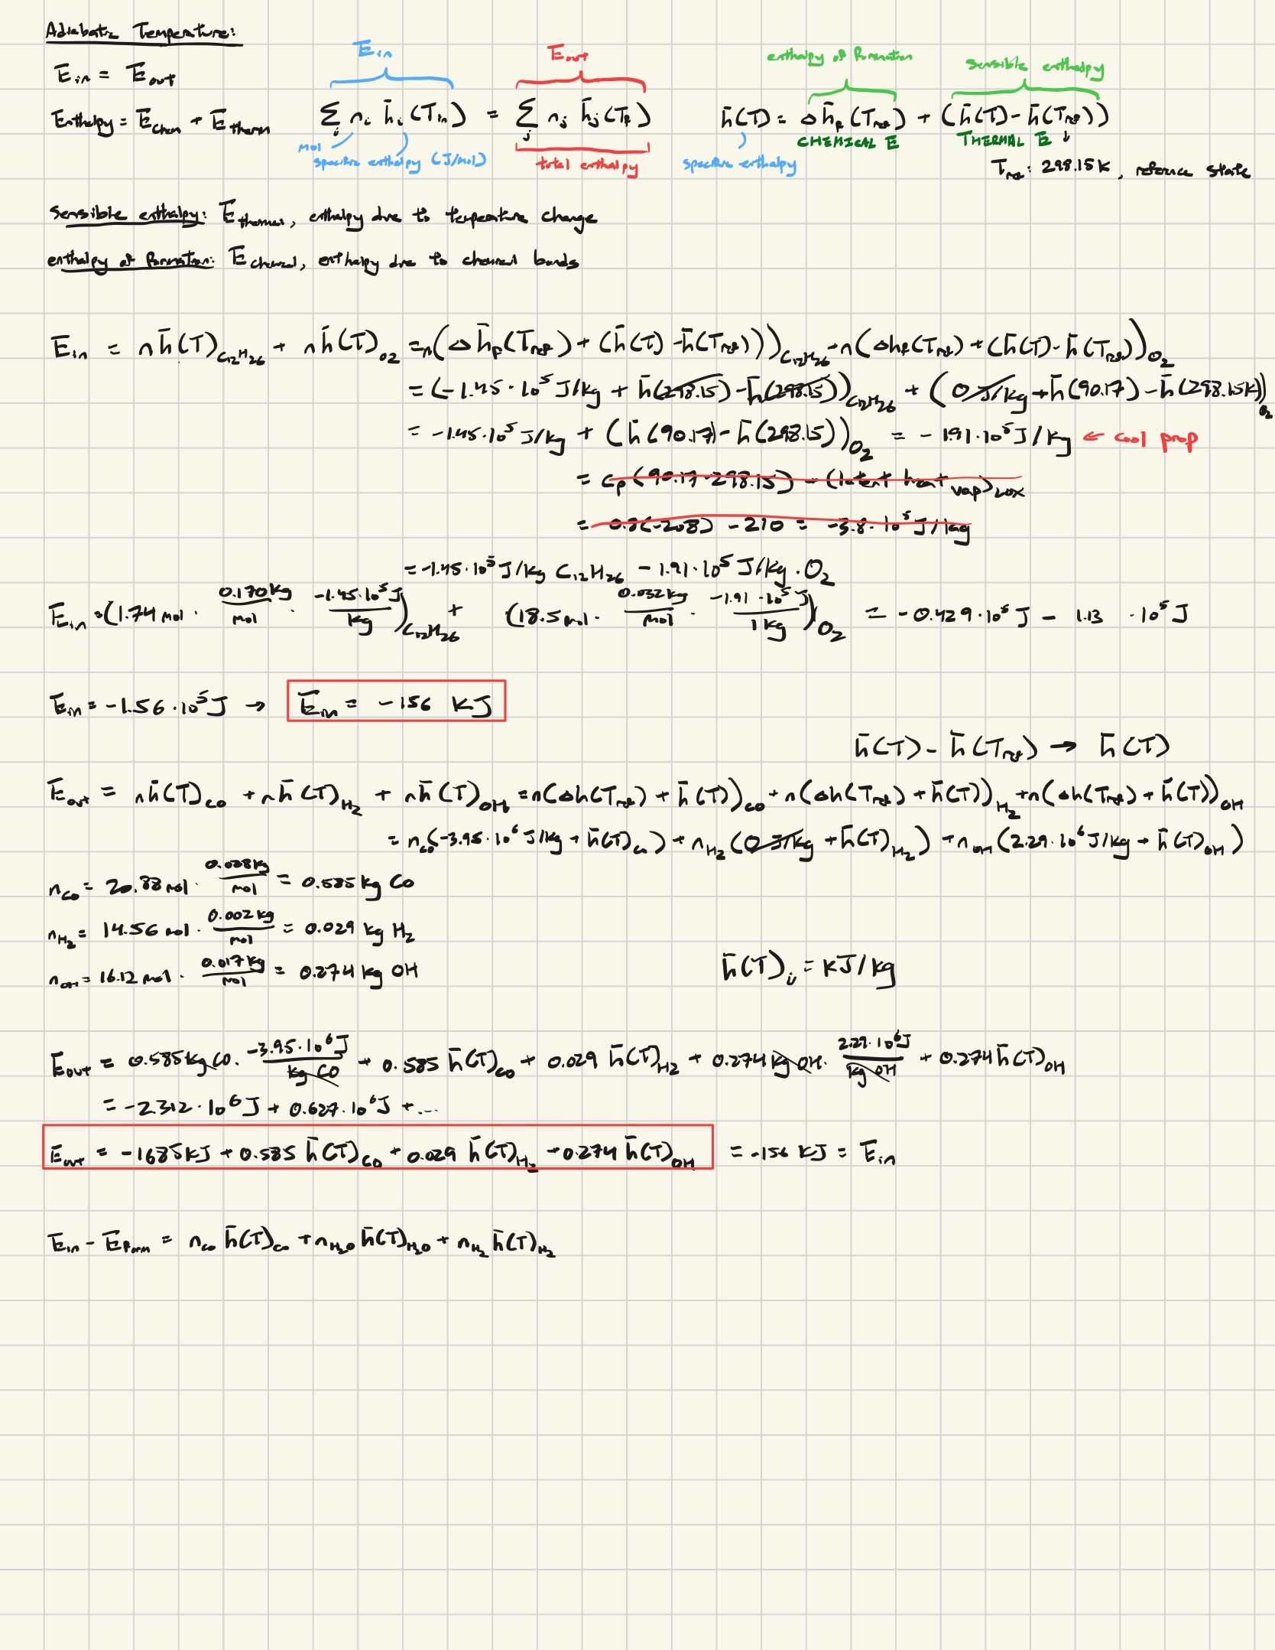


Workflow
MR = 2.0 -> ⦰ = 1.74
Python function(): iterate through T and minimize residual
Balance RP1-LOX combustion reaction
$$1.74C_{12}H_{26}+18.5O_{2} →n_{CO}CO+n_{H2O}H_{2}O+n_{H2}H_{2}$$
200 iterations
T = 3404.6 K
Solve system of 3 equations
Isentropic Flow Equations
$$𝒳_{CO}=0.4800, 𝒳_{H2O}=0.3716,𝒳_{H2}=0.1484$$
Conservation of energy
Plug in enthalpies of formation

Slide 5
Mole Fractions
Species | CEA | CO H20 H2 | % Error | CO H2O CO2 | % Error | CO H2 CO2 | % Error | CO H2 OH | % Error
CO | 0.4167 | 0.4800 | +15.20% | NA | NA | 0.1084 | -73.98% | 0.4048 | -2.85%
H20 | 0.2684 | 0.3716 | +38.43% | NA | NA | ~ | ~ | ~ | ~
H2 | 0.1854 | 0.1484 | -19.94% | ~ | ~ | 0.5200 | 180.52% | 0.2818 | +52.02%
CO2 | 0.0765 | ~ | ~ | NA | NA | 0.3716 | 386% | ~ | ~
H | 0.0310 | ~ | ~ | ~ | ~ | ~ | ~ | ~ | ~
OH | 0.0192 | ~ | ~ | ~ | ~ | ~ | ~ | 0.3134 | +1529%

Slide 6
Discussion
Why does the concentrations vary between your model and CEA?
My model only uses 3 species while CEA accounts for all species
The more major species I correctly choose, the more accurate my mole fractions are
CO, H2O, and H2 most accurate, while CO, H2, and OH least accurate
How can you make your model more accurate?
Use the Kp formula and water-gas shift reaction
5 equations can now solve for 5 species
Each species’ fractions become more accurate. The 5 major species make up 97.8% of the products concentration.
Alternatively, write a program to minimize the Gibbs function G(T,p) to get all minor species

Slide 7
Critical Values
Quantity | CEA | CO H20 H2 | % Err | CO H2O CO2 | % Err | CO H2 OH | % Err
Adiabatic Flame Temperature (K) | 3257 | 3405 | +4.53% | 3897 | +19.65% | 1254 | -61.51%
Chamber Molecular Weight (g/mol) | 20.67 | 20.44 | -1.11% | 20.44 | -1.12% | 17.23 | -16.64%
Chamber Specific Heat Ratio | 1.162 | 1.228 | +5.68% | 1.252 | +7.74% | 1.325 | +14.03%
Exhaust Mach Number | 2.777 | 2.779 | +0.07% | 2.791 | +0.50% | 2.832 | 1.98%
Exhaust Temperature (K) | 1669 | 1809 | +8.40% | 1968 | +17.91% | 545 | -67.34%
Exhaust Velocity (m/s) | 2594 | 2642 | +1.87% | 2793 | +7.69% | 1671 | -35.57%
Specific Impulse (s) | 264 | 269 | 1.71% | 284.8 | +7.69% | 170 | -35.72%

Slide 8
Discussion
How much does your model vary from CEA and why?
CO, H2O, and H2: low error of +0.07% (Me), high error of +8.40% (Te)
Fairly accurate because uses the 3 major species of RP1-LOX reaction
What are the shortcomings of your model?
Doesn’t use all species, so critical values will have noticeable error
What are some improvement techniques?
Minimize Gibbs free energy to get all minor species for higher accuracy
How could you extend it to become a general equilibrium solver?
Code is currently generalizable for any reaction with H, C, and O
Account for other elements like N, which would add a fourth equation

Slide 9
TCA Contour

Slide 10



Workflow
NFZ model
Find MR to maximize Isp
pyplot(x=MR, y=Isp)
Verify Tc is reasonable
pyplot(x=MR, y=Tc)
Calculate Cf and eps
$$C_{f},P_{e}=rocketcea(P_{amb}, P_{c},MR,𝓔)$$
Calculate performance variables
$$A_{t}=\frac{τ}{C_{f}P_{c}},c^{∗}=\frac{I_{sp}g_{0}}{C_{f}},\dot{\dot{m}=\frac{P_{c}A_{t}}{c^{∗}},etc.}$$
Select geometric variables
Nozzle shape, chamber length, contraction ratio, etc.

Slide 11

MR = 2.4
Maximize Isp
Ensure Tc at that MR is not too hot for the engine
NFZ Model = 2
NFZ = 2: Assume equilibrium in chamber and frozen at throat
Chamber: the reaction happens so fast that it’s always in equilibrium, meaning net reaction rate = 0
Throat: the expansion happens so fast that the reaction essentially “freezes”, meaning mole fractions stays fixed
This is the most accurate assumption, balanced between equilibrium flow (higher Isp), and frozen flow (lower Isp)

Slide 12
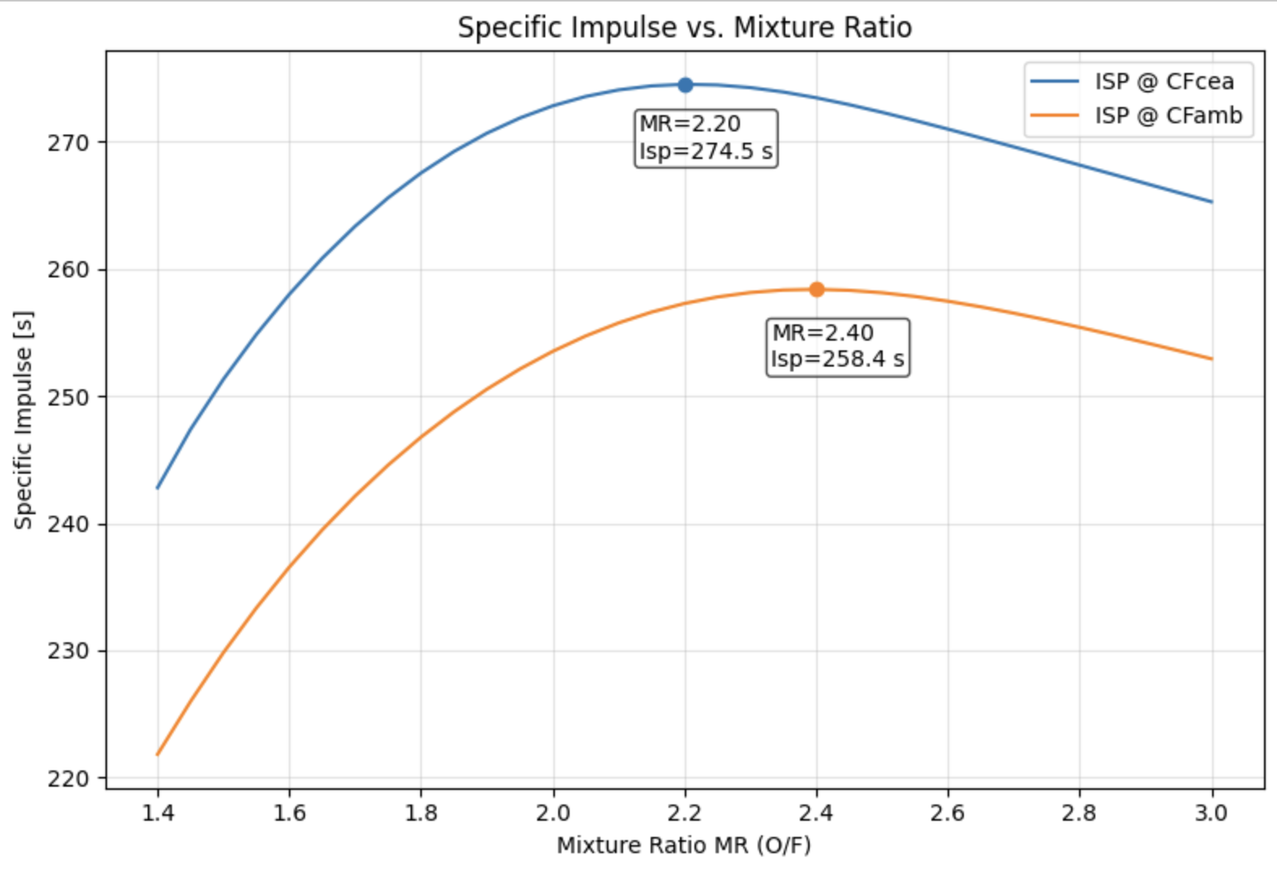
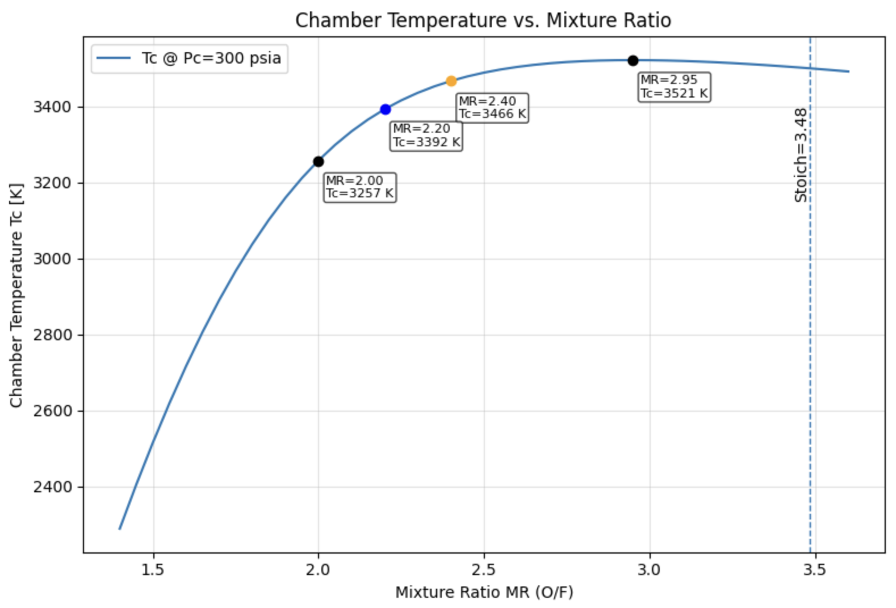
MR = 2.4

Slide 13
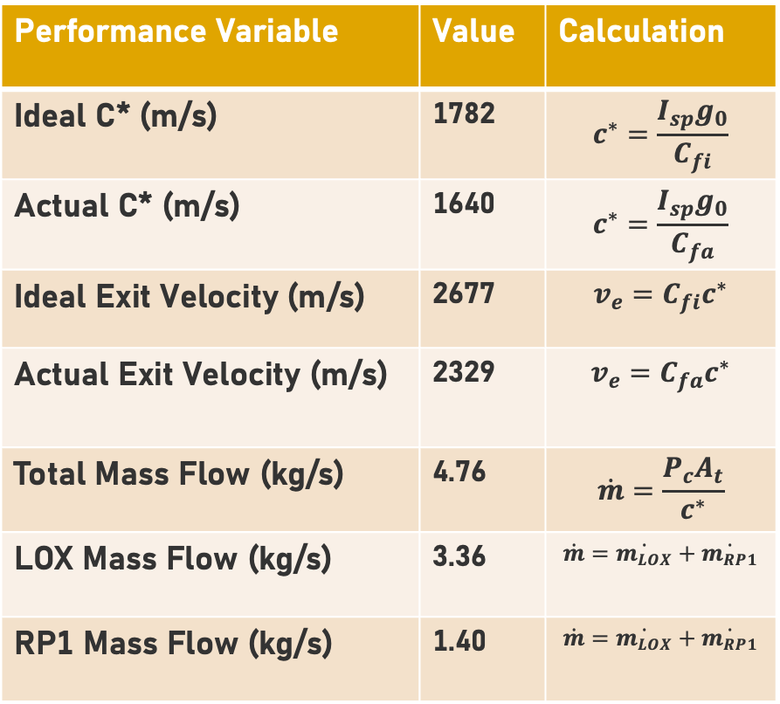
Performance Variables
Design Variable | Value | Calculation
Mixture Ratio | 2.4 | f(Isp, Tc)
Performance Variables | Value | Calculation
Specific Impulse (s) | 258 | f(MR)
Chamber Temperature (K) | 3466 | f(MR)
Ideal Thrust Coefficient | 1.50 | cea(MR, Pc, Pamb, e)
Actual Thrust Coefficient | 1.42 | cea(MR, Pc, Pamb, e)
Performance Variable | Value | Calculation
Ideal C* (m/s) | 1782 | $$c^{∗}=\frac{I_{sp}g_{0}}{C_{fi}}$$
Actual C* (m/s) | 1640 | $$c^{∗}=\frac{I_{sp}g_{0}}{C_{fa}}$$
Ideal Exit Velocity (m/s) | 2677 | $$v_{e}=C_{fi}c^{∗}$$
Actual Exit Velocity (m/s) | 2329 | $$v_{e}=C_{fa}c^{∗}$$
Total Mass Flow (kg/s) | 4.76 | $$\dot{m}=\frac{P_{c}A_{t}}{c^{∗}}$$
LOX Mass Flow (kg/s) | 3.36 | $$\dot{m}=\dot{m_{LOX}}+\dot{m_{RP1}}$$
RP1 Mass Flow (kg/s) | 1.40 | $$\dot{m}=\dot{m_{LOX}}+\dot{m_{RP1}}$$

Slide 14
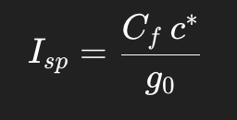
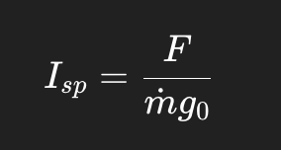
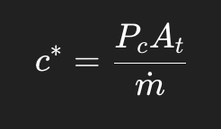
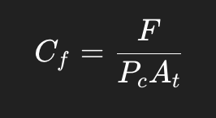
Discussion
Specific Impulse (s)
How efficient the engine is
Higher Isp = more Δv for the same propellant mass
Factors in optimizing Isp
Propellant choice, MR
Characteristic Velocity (m/s)
Quality of combustion in the chamber
Factors in optimizing C*
Injector design, chamber length
Thrust Coefficient
How effectively the nozzle converts Pc to thrust
Factors in optimizing Cf
Eps: balance between underexpanded and overexpanded

Slide 15
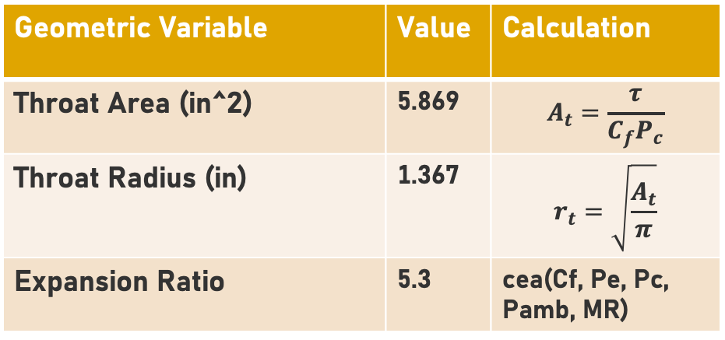
Geometric Variables
Geometric Variable | Value | Range
Nozzle Shape | Bell | N/A
Chamber Cylindrical Length (in) | 8.5 | N/A
Contraction Ratio | 3.5 | 3-4
Convergence Half-Angle (°) | 37.5 | 35-40
Convergence Radius (Rc/Rt) | 1.25 | 1.0-1.5
Lead-in Radius (Rtc/Rt) | 1.5 | 1.5
Divergence Half-Angle (°) | 15 | 12-18
Divergence Entrance Angle (°) | 30 | 30-32
Divergence Exit Angle (°) | 8 | 8-9
Percent Bell Lf (%) | 70 | 60-80
Geometric Variable | Value | Calculation
Throat Area (in^2) | 5.869 | $$A_{t}=\frac{τ}{C_{f}P_{c}}$$
Throat Radius (in) | 1.367 | $$r_{t}=\sqrt{\frac{A_{t}}{π}}$$
Expansion Ratio | 5.3 | cea(Cf, Pe, Pc, Pamb, MR)

Slide 16
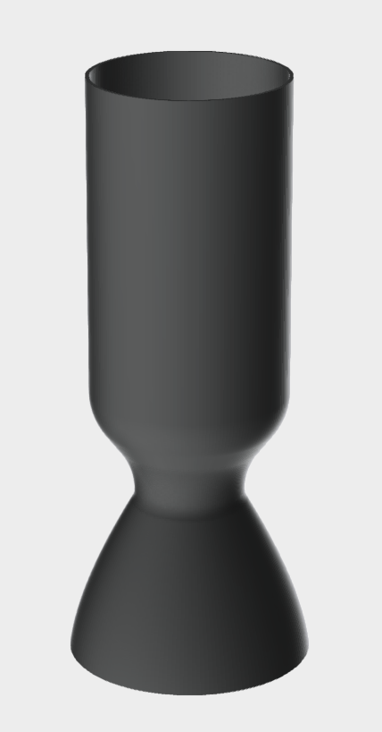
TCA Contour

Slide 17
Next Steps
TCA Part 2
CFD Analysis
Fullscale Engine Dev project🙏

Slide 18
Thanks for Listening

